Slide 1







Hello!
Levy Lozada
Police Chief Inspector
09189448682
levylozada@gmail.com
Certified

Slide 2
Introduction to Digital Forensic

Slide 3
Course Introduction
What you will learn:
Identification and seizure of electronic evidence
Digital forensic principles and tools
Techniques for searching and identifying evidence on digital media pertinent to a case
Notes:
Identification and seizure of electronic evidence, includes identifying what computer peripherals or components that may contain digital information that may use as evidence.
Digital Forensic Principles includes identification and collection of evidence, preservation and acquisition of evidence, examination and analysis, reporting and court presentation.
Techniques for searching and identifying evidence, this includes hash analysis, signature analysis, recovering of deleted files, windows artifacts, internet artifacts etc..

Slide 4

Participants Introduction
Please Provide:
Name
Position
Experience in digital forensic
Course expectation

Slide 5
Course Schedule
Day 1 | Modules
 | Course introduction Identification and seizure of electronic evidence
 | Imaging: Forensic acquisition of digital evidence Forensic Tools Overview
 | Hash analysis Signature analysis

Slide 6
Course Schedule
Day 2 | Modules
 | Search techniques Windows artifacts
 | Internet artifacts Email artifacts
 | Logical Data storage Analysis of Volatile Data
 | Reporting

Slide 7
The more I learn, the more I learn that I need to learn more.
- unknown
Albert Einstein — 'The more I learn, the more I realize how much I don't know.'
Aristotle — 'The more you know, the more you know you don't know.'
Socrates —’The more I learn, the more I learn how little I know.

Slide 8
Thanks!
Any questions?

Slide 9
Understanding Digital Forensic
Digital Evidence

Slide 10
What is Digital Forensic?
Digital Forensic
The scientific examination and analysis of data held on or retrieved from computer storage media or network and its presentation in a manner legally acceptable to a Court
Notes:
What is Computer ?
Refers to an electronic, magnetic, optical, electrochemical, or other data processing or communications device, or grouping of such devices, capable of performing logical, arithmetic, routing, or storage functions and which includes any storage facility or equipment or communications facility or equipment directly related to or operating in conjunction with such device. It covers any type of computer device including devices with data processing capabilities like mobile phones, smart phones, computer networks and other devices connected to the internet. (R.A. 10175)
What is Computer Data?
Refers to any representation of facts, information, or concepts in a form suitable for processing in a computer system including a program suitable to cause a computer system to perform a function and includes electronic documents and/or electronic data messages whether stored in local computer systems or online. (R.A. 10175)

Slide 11
What is Digital Evidence?
Digital Evidence
Refers to digital information that may be used as evidence in a case
Any information being subject to human intervention or not, that can be extracted from a computer system
Must be in human-readable format or capable of being interpreted by a person with expertise in the subject
Notes:
What is Digital Evidence?
Refers to digital information that may be used as evidence in a case.
Any information being subject to human intervention or not, that can be extracted from a computer.
Must be in human-readable format or capable of being interpreted by a person with expertise in the subject.
The gathering of the digital information may be carried out by confiscation of the storage media (data carrier), the tapping or monitoring of network traffic, or the making of digital copies (e.g. forensic images, file copies, etc.) of the data held. (IRR R.A. 10175)

Slide 12
Digital Forensic Examples
Recovering evidence from deliberately formatted hard drive
Recovering thousands of deleted emails and chat messages
Recovering internet artifacts and file’s metadata
Performing computer related crime investigation

Slide 13

Why Digital Forensic
Data as seen by common users using windows explorer, cmd shell, web browser
Data as seen by forensic investigator using sophisticated forensic tools.
These data may
include deleted,
hidden, encrypted, etc
Notes:
R.A 10175 SEC.15 Search, Seizure and Examination of Computer Data
The law enforcement authorities may order any person who has knowledge about the functioning of the computer system and the measures to protect and preserve the computer data therein to provide, as is reasonable, the necessary information, to enable the undertaking of the search, seizure and examination.

Slide 14


Why Digital Forensic?
Any person can gather
information from a computer
“ BUT “
The Forensic element means it has to be gathered in a manner which makes it reliable to a Court or other body and the information has to become
“ EVIDENCE ”
Notes:
R.A 10175 SEC.15 Search, Seizure and Examination of Computer Data
The law enforcement authorities may order any person who has knowledge about the functioning of the computer system and the measures to protect and preserve the computer data therein to provide, as is reasonable, the necessary information, to enable the undertaking of the search, seizure and examination.

Slide 15


Not a law, but…
Non-compliance will often make evidence inadmissible
http://www.7safe.com/electronic_evidence/ACPO_guidelines_computer_evidence.pdf

Slide 16
ACPO Digital Evidence Principles
Principle 1 – Primary Rule…
No action taken by the law enforcement agencies or their agents should change the data held on a computer or other media which may subsequently be relied upon in Court.
Where possible computer data must be ‘imaged’ and that version be examined.
Principle 2
In exceptional circumstances it may be necessary to access the original data held on a target computer.
However it is imperative that the person doing so is competent and can account for their actions.
Principle 3
An audit trail or other record of all processes applied to digital evidence should be created and preserved. An independent third party should be able to examine these processes and achieve the same result.
Principle 4
The person in charge of the case has overall responsibility for ensuring that a computer has been correctly examined in accordance with the law and these principles.

Slide 17

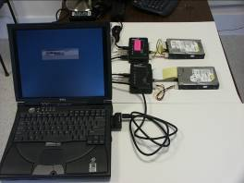
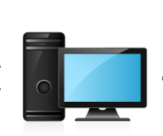


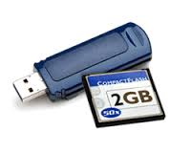
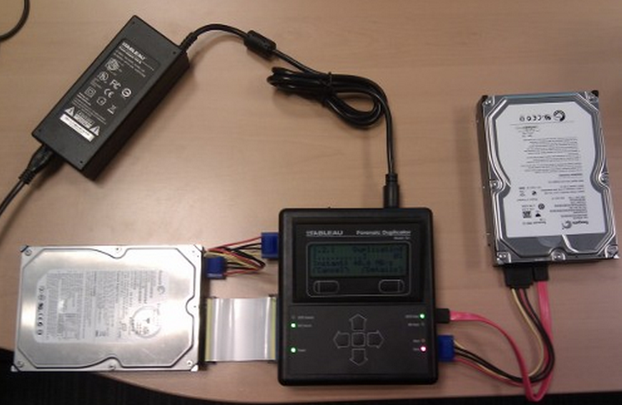







Digital Forensic Process
Identification
Acquisition/
Imaging
Analysis
Reporting
Court Presentation
MD5 = ABC123
MD5 = ABC123
Notes:
Identification
This step involves identifying what type of storage media and what data or information could be recovered relative to the investigation or case.
Acquisition/ Imaging
Physically or remotely obtaining possession of the computer data from the original digital storage media through digital forensic imaging process.
Imaging is the second phase and requires
forensically-sound procedures and validated tools.
This should be processed by trained digital forensic examiner using validated hardware and software tools.
Analysis
Evaluating the information or data recovered from the storage media evidence to determine if and how it could be used against the suspect.
Analyzing
digital information
Identifying traces of
network / computer intrusion
Identifying & examining
malicious files.
Employing techniques to
crack file & system passwords.
Detecting
Steganography
Recovering deleted,
fragmented & corrupted data
Analyzing Online Activities
Reporting
Once the analysis is complete, a report is generated. This report may be a written report, oral testimony, or some combination of the two.
Court Presentation
This step involves the presentation of evidence discovered, in a manner which is understood by lawyers, non technically staff/management, and suitable as evidence as determined by the rules on electronic evidence or any related law.

Slide 18
Thanks!
Any questions?

